Slide 1
MANDIBHAV.COM
Shri Shankaracharya Institute of Professional Management & Technology, Raipur
Minor Project Report on
CSE 7th Semester
Department of Computer Science and Engineering,
Batch 2018-2022
Session July – Dec 2021
Project Group Members:
Harsh Singh Chouhan, 303302218061
Amrinder Pal Singh Bains, 303302218122
Shirish Sahu, 303302218056
Project Guide
Mr. Dheeraj Kumar Ghaghre
(Assistant Professor, CSE)

Slide 2
CONTENTS:-
APPLICATION AREA
PROJECT OVERVIEW
PROJECT REQUIREMENTS (DEVELOPER)
PROJECT REQUIREMENTS (END USER)
BACK END DETAILS
FRONT END DETAILS
PROJECT FLOW DIAGRAM
DATA FLOW DIAGRAM
RESULT & CONCLUSION
REFERENCES

Slide 3
Application Area
Why did you opt to work on this project?
The reason we opt for this project is that we know the condition and difficulties of farmers to sell their product . This project will help farmers to sell the produce at a better rate. So this website site is very helpful in farmer and rural development area. Buying and selling things are somewhere different for rural and urban area people, so we are creating a rural area e commerce platform to fulfill the demands of a rural environment.
Who are the End Users of this project?
Buyer and Seller are the end users

Slide 4
Application Area
What are the Applications and Benefits of this project?
The applications of this project are:
It will allow web application to streamline the operations
To know the price status of vegetable markets .The rural public is the end user of this platform.
Farmer can also deliver the product by himself and gain more profit
The benefits of this project are :
Cost effective
Reduce the selling problems of farmers
Easy to handle and use
Helps farmers & Saves Time

Slide 5
Project Overview
Time and money saving things grows in a fast way. This is the most common factor for any individual, organization or country. This is the reason why e-commerce industry growing day by day with high efficiency. A vegetable market is a type of building or structure created and designed in various colors, materials, shapes, sizes, and styles with accurate and specific fruit and vegetables. Vegetable markets provide healthier food items that are fresher than the ones available in supermarkets. This project is also based on e-commerce platform, but this platform is designed for former and rural development area people by keeping in mind the requirements and issues of rural area people who faces problem to sell produces.
Features:-
Easy login & registration
User-friendly, easy to sell or buy
Checking item availability in specific locations
Provide prediction for the price of vegetables.
Provide information about market and vegetables.

Slide 6
Project Requirements (Developer)
Software Required
Text editor (Ex. Notepad++ v8.1.2)
Browser (Ex. Chrome v95.0.4638.54)
JS supported server (Ex. XAMPP Server v3.2.2)
Hardware Required
Processor: Minimum 1 GHz is required
Ethernet connection (LAN) or a wireless adapter (Wi-Fi) for internet connection.
Hard Drive: Minimum 32 GB required
Memory (RAM): Minimum 1 GB to run smoothly.
Other components like Monitor, Keyboard, and Mouse etc.

Slide 7
Project Requirements (End User)
Software’s Required
Operating System: Windows 10 Version 1507
Browser (Ex. Chrome v95.0.4638.54) with internet connectivity.
Hardware Required
Internet connection
Smartphone etc

Slide 8
Back End Details
What Back End your project is using?
Node js
MySQL (v5.0.11)
JQueryAJAX (v3.5.1)
How Many Databases?
( 1 DATABASE )My SQL
How Many Tables?
three

Slide 9
Front End Details
How many Interfaces / Screens your Application will have?
SIX
For Common User
For Admin
For Uploading
For Showing the result
Form Page
For Searching
Front end Languages
Bootstrap(v4)
HTML(v5)
CSS(v3)
JAVA SCRIPT

Slide 10
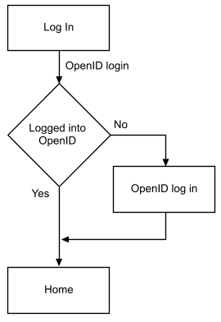
Project Flow Diagram

Slide 11
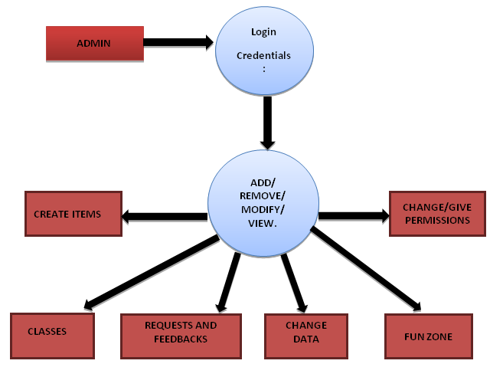
Data Flow Diagram

Slide 12
Result & Conclusion
In this project the main outcome is for the farmer that he can sell the product by himself at better rate and the whole profit will get to the farmer and also he don’t need to take help of an agent due to which he will not give any amount to agent. Also he can deliver p Use of information technology in agriculture can change the scenario of decision making and farmers can yield in a better way.
Agriculture is the utmost important area especially in the mellowing country like India. Use of information technology in agriculture can change the scenario of decision making and framers can yield in a better way. In this project, we will suggest the farmer to get the better profit by selling the product with the help of this project directly to the customer or a user.

Slide 13
References
The Road to Learn React: Your journey to master plain yet pragmatic React.js by Robin Wieruch.
AGRICULTURAL MARKETING AND MANAGEMENT SYSTEM.
Department of Rural Development FOOD:-Agriculture and Formers Welfare. Consumer Affairs, Food and Public Distribution etc…
2. Dr. Rashmi Singh (2020). “Possibilities of E-Commerce in Rural Areas of the Harda District in Madya Pradesh”” International Journal of Innovative Research in Technology and Science, Volume 8, Issue 2
3. Anil Kumar S. Hagargi(2011).“Rural Market in India: Some Opportunities and Challenges” International Journal of Exclusive Management Research
Web Resources
https://reactjs.org/
https://www.w3schools.com/REACT/DEFAULT.ASP
https://www.tutorialspoint.com/mysql/index.htm

